Slide 1
Strong gravity and relativistic accretion disks around supermassive black holes
Predrag Jovanović
Astronomical Observatory
Belgrade, Serbia

Slide 2
Outline
Supermassive black holes (SMBHs) in nuclei of active galaxies
Relativistic accretion disks around SMBHs
Observational effects of strong gravity on the radiation emitted from accretion disk
Our investigations: simulations of relativistic accretion disks using ray-tracing in Kerr metric
Results: simulations vs observations
Conclusions

Slide 3
Black holes in nature
classification according to the metric:
  Schwarzschild (non-rotating and uncharged)
  Kerr (rotating and uncharged)
  Reissner–Nordström (non-rotating and charged)
  Kerr–Newman (rotating and charged)
classification according to their masses:
  Mini, micro or quantum mechanical: M_{BH}  M (primordial black holes in the early universe)
  stellar-mass: M_{BH} < 10² M (in the X-ray binary systems)
  intermediate-mass: M_{BH}  10² − 10⁵ M (in the centers of globular clusters)
  supermassive: M_{BH}  10⁵ − 10¹⁰ M (in the centers of all galaxies, including ours)

Slide 4
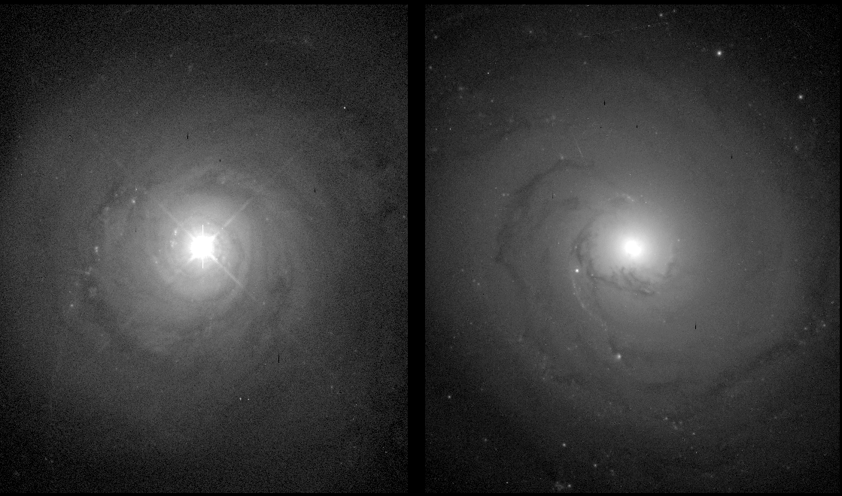
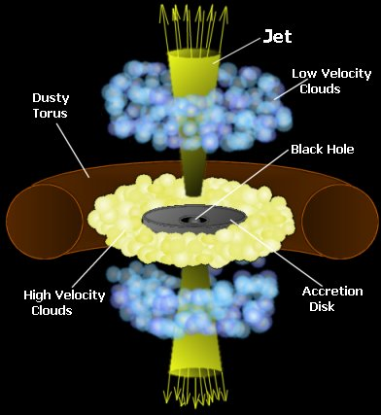
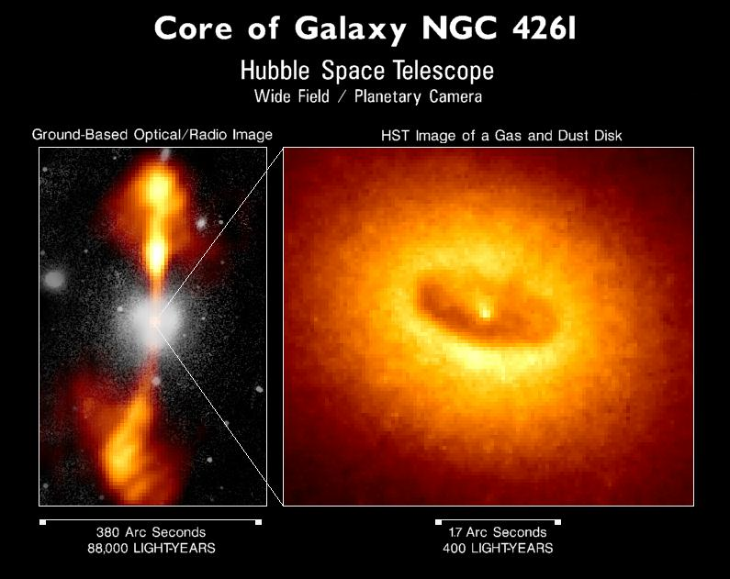
SMBHs in Active Galaxies
Left: NGC 5548 (Seyfert galalaxy)
Right: NGC 3277 (regular galaxy)
Small very bright core embedded in an otherwise typical galaxy

Slide 5
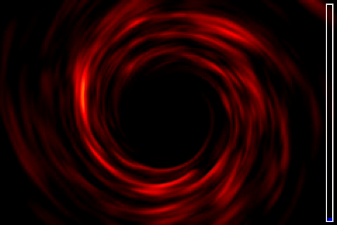
Armitage, P. J., Reynolds, C. S. 2003, MNRAS, 341, 1041

Slide 6
Fe Kα spectral line
The Fe Kα line profile from Seyfert I galaxy MCG-6-30-15 observed by the ASCA (Tanaka, Y. et al, 1995, Nature, 375, 659) and the modeled profile expected from an accretion disk around a Schwarzschild BH.
broad emission spectral line at 6.4 keV
asymetric profile with narrow bright blue peak and wide faint red peak
Line width corresponds to velocity:
v ~ 100.000 km/s (MCG-6-30-15)
v ~ 48.000 km/s (MCG-5-23-16)
v ~ 20000 – 30000 km/s (many other)

Slide 7
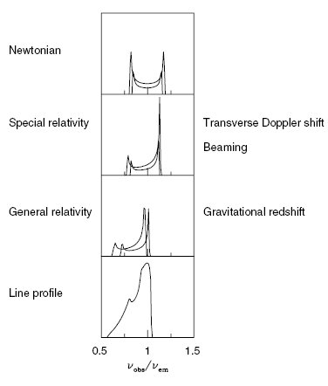

Relativistic effects on Fe Kα line
Doppler shift: symmetric, double-peaked profile
Relativistic beaming: enhance blue peak relative to red peak
Gravitational redshift (smearing blue emission into red):
Fabian, A. C. 2006, AN, 327, 943

Slide 8
Our investigations and results
Modeling of emission of an accretion disk around a SMBH using numerical simulations based on a ray-tracing method in Kerr metric (first results obtained in 2001.)
Investigation of the observational effects of strong gravitational field around a SMBH
Studying the variability due to:
  internal causes: perturbations of disk emissivity
  external causes: gravitational microlensing
Overview: Jovanović P., Popović L. Č., 2009, chapter in book “Black Holes and Galaxy Formation”, Nova Science Publishers Inc, Hauppauge NY, USA, 249-294 (arXiv:0903.0978)

Slide 9

Ray-tracing in Kerr metric
in units where
horizon of BH:
radius of marginally stable orbit:
Two approaches:
  integrating the null geodesic equations starting from a given initial position in the disk to the observer at infinity
  tracing rays following the trajectories from the sky plane to the disk (only those photon trajectories that reach observer's sky plane are considered

Slide 10
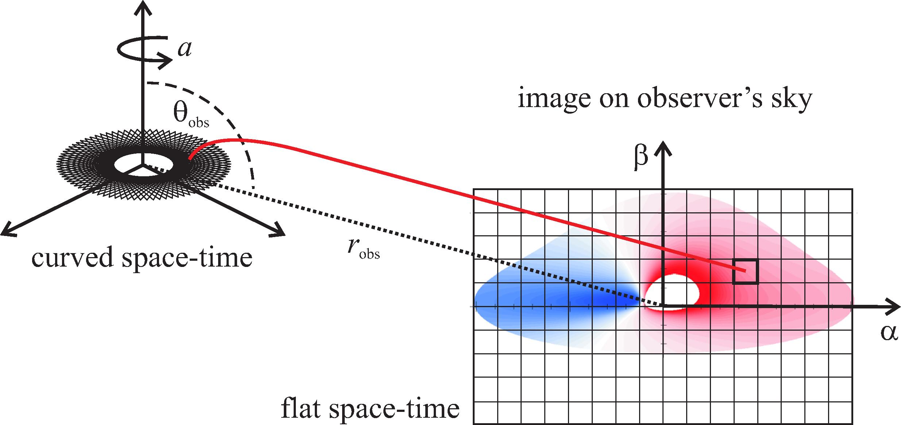

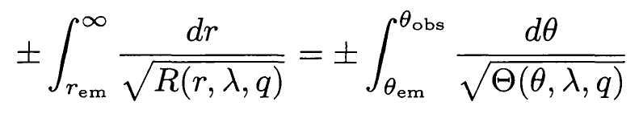
Surface emissivity of the disk:
Total observed flux:

Slide 11
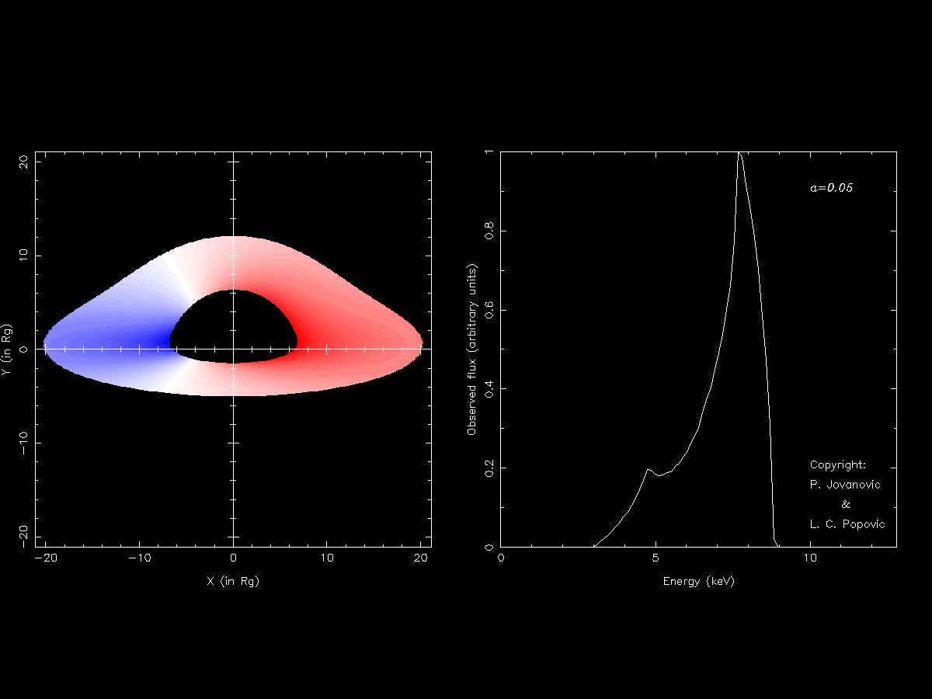
Numerical simulations of a highly inclined accretion disk (i=75º) for different values of angular momentum parameter a (left) and the corresponding profiles of the Fe Kα line (right)

Slide 12
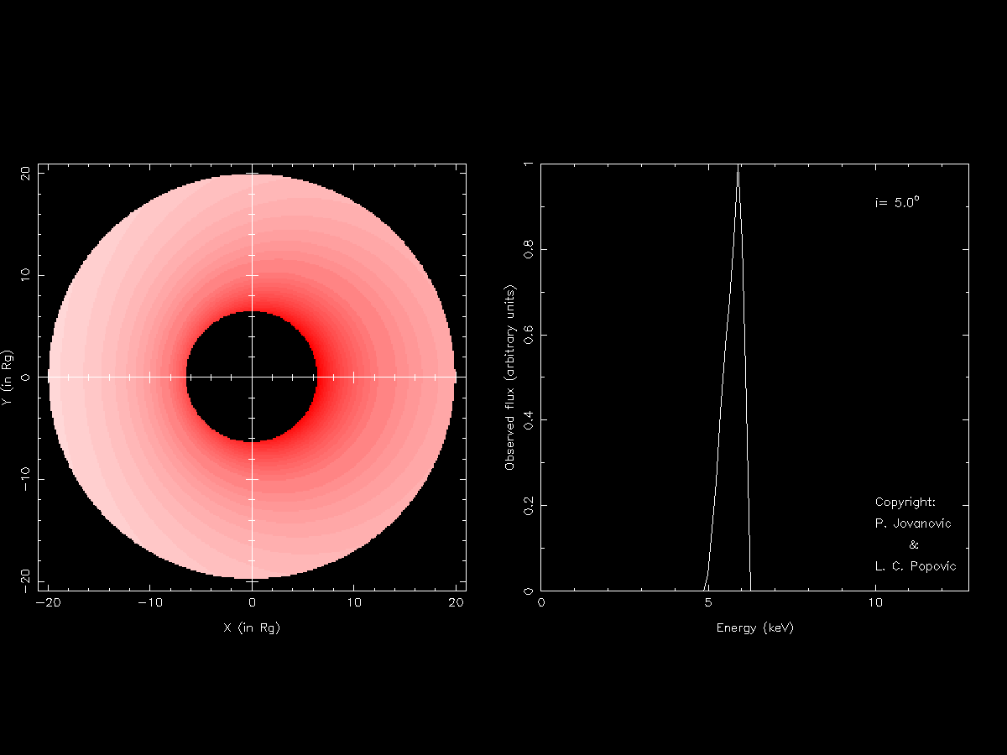
Numerical simulations of an accretion disk in Schwarzschild metric for different inclination angles i (left) and the corresponding profiles of the Fe Kα line (right)

Slide 13
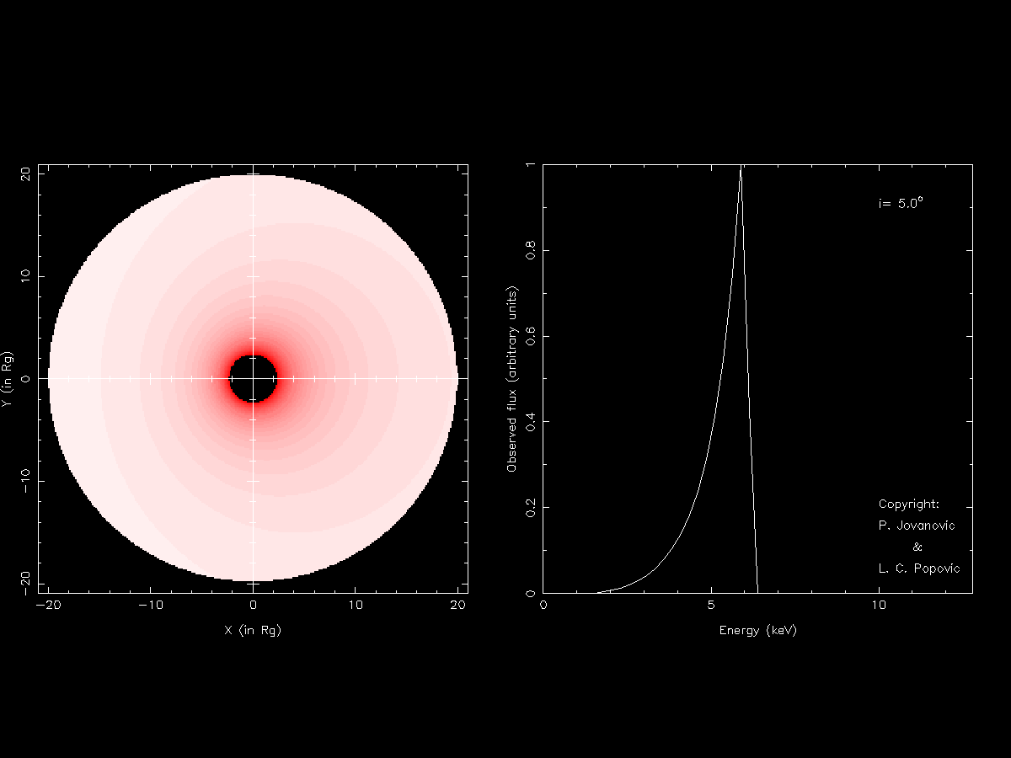
Numerical simulations of an accretion disk in Kerr metric with angular momentum parameter a = 0.998 for different inclination angles i (left) and the corresponding profiles of the Fe Kα line (right)

Slide 14
Left: illustrations of the Fe Kα line emitting region in form of narrow ring
Right: the corresponding Fe Kα line profiles.
P. Jovanović &
L. Č. Popović, 2008, Fortschr. Phys. 56, No. 4 – 5, 456

Slide 15
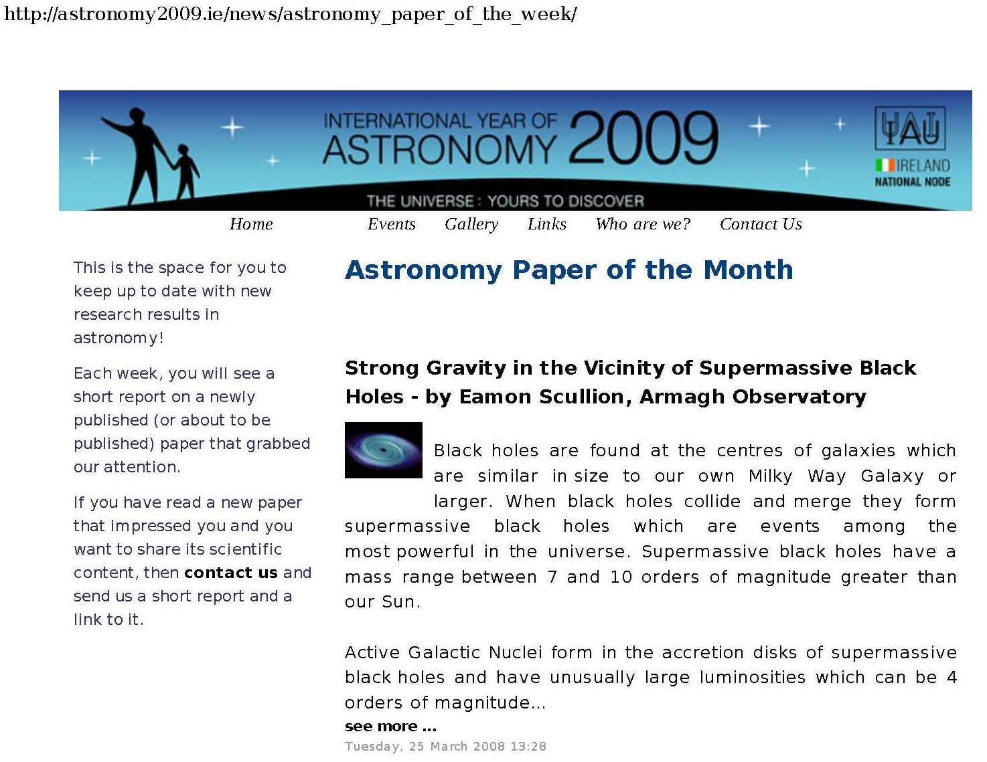
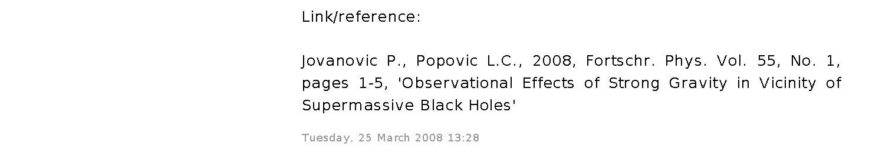

Slide 16
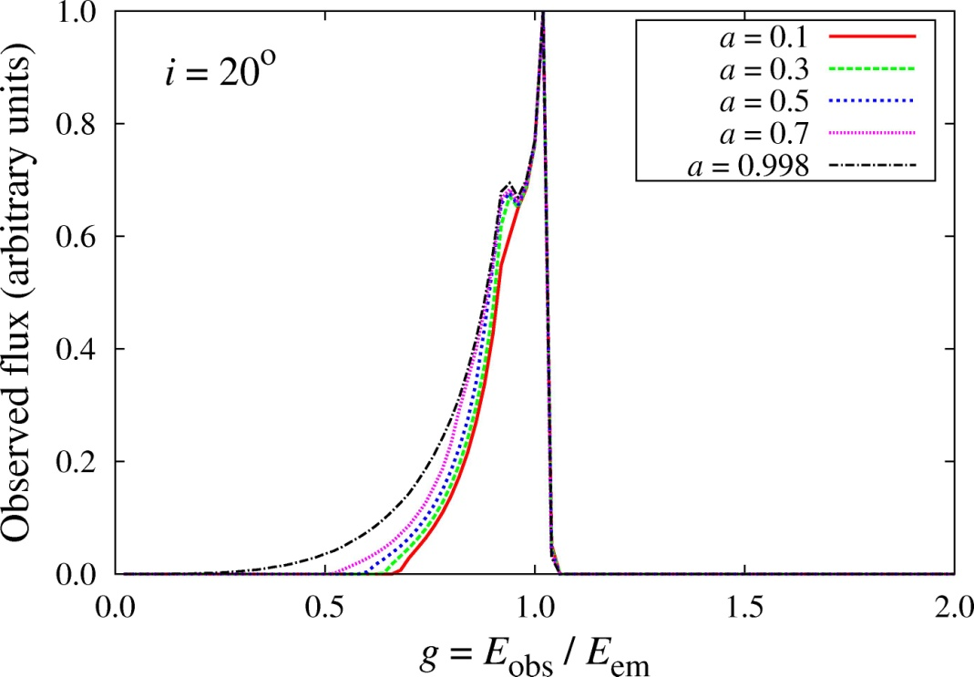
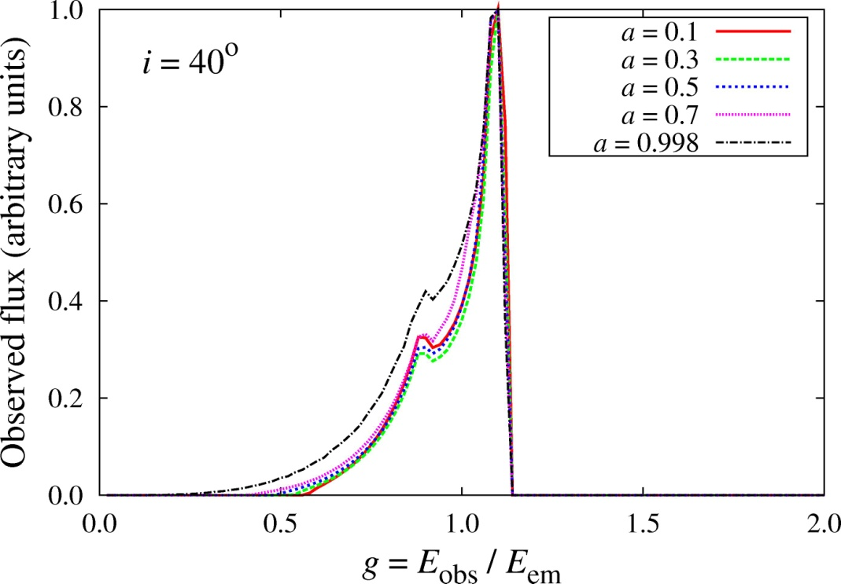
Modeled Fe Kα spectral line profiles for several values of angular momentum parameter a, and for inclination angle i = 20º (left) and i = 40º (right)
Jovanović, Borka Jovanović, Borka, 2011, Baltic Astronomy, 20, 468

Slide 17
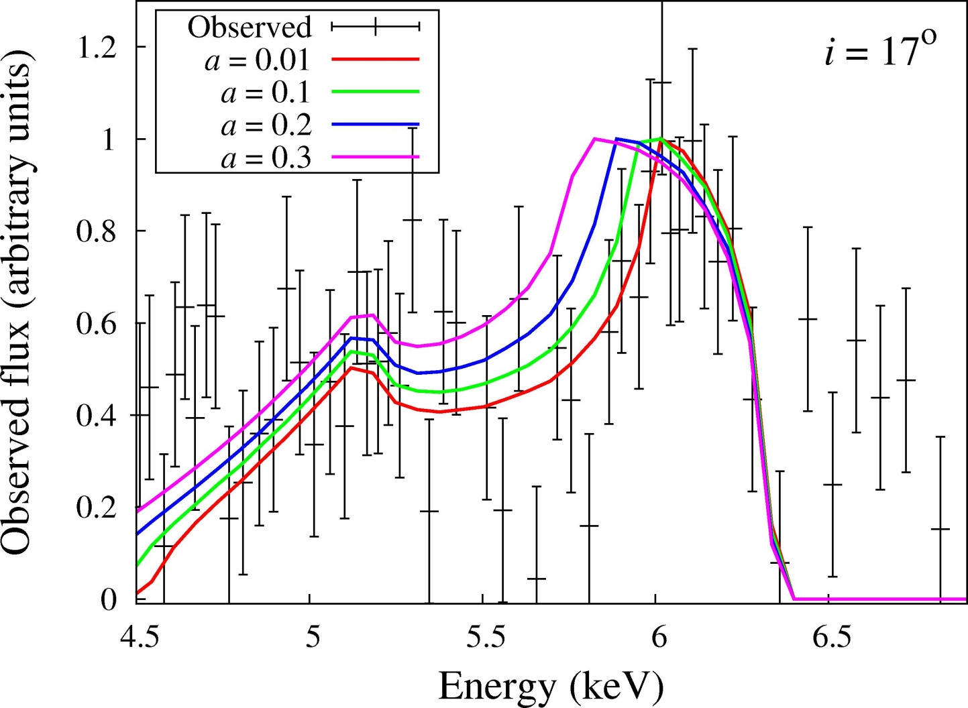
Observations of the Fe Kα line in the case of the nucleus of Cygnus A (3C 405) (black crosses with error bars) observed by Chandra, and the corresponding simulated profiles for 4 different values of black hole spin (solid color lines).
Jovanović, Borka Jovanović, Borka, 2011, Baltic Astronomy, 20, 468

Slide 18
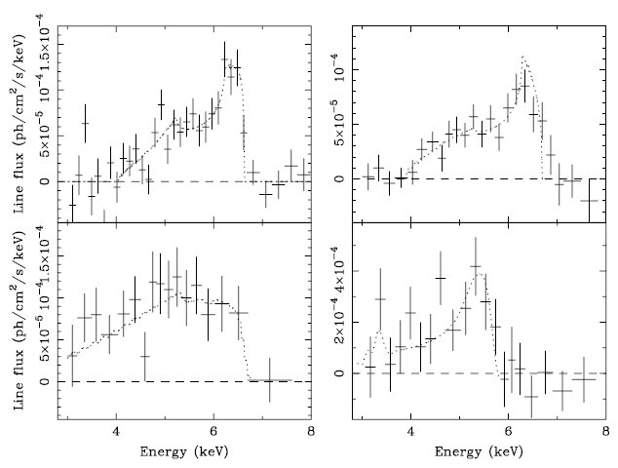
Observed variability of the Fe Kα line
1994
1997
MCG-6-30-15
Time-avg
Peculiar
Reynolds, C. S., Nowak, M. A. 2003, Physics Reports, 377, 389

Slide 19
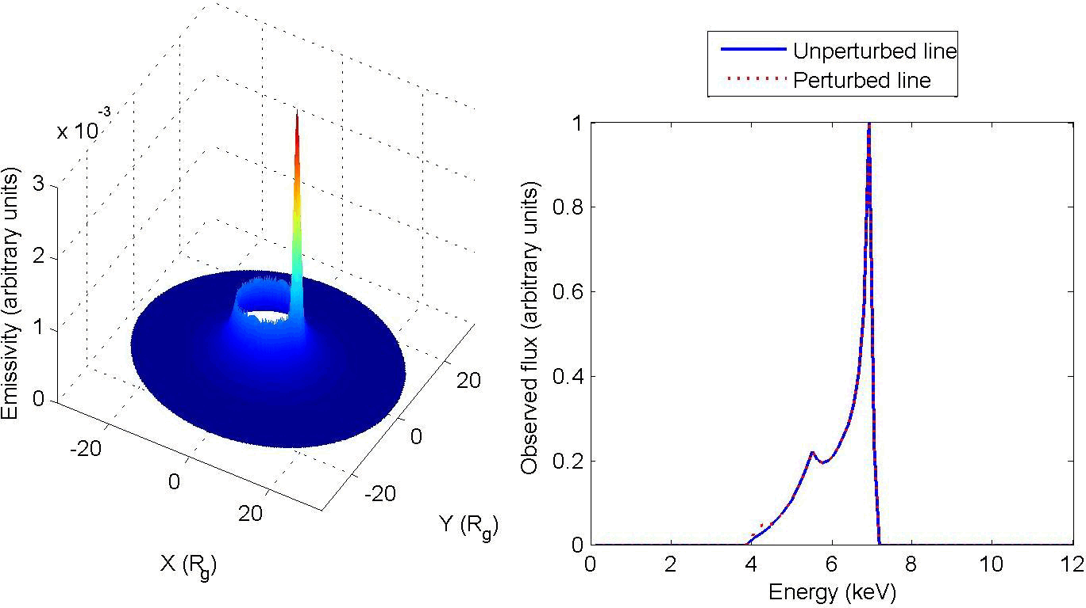
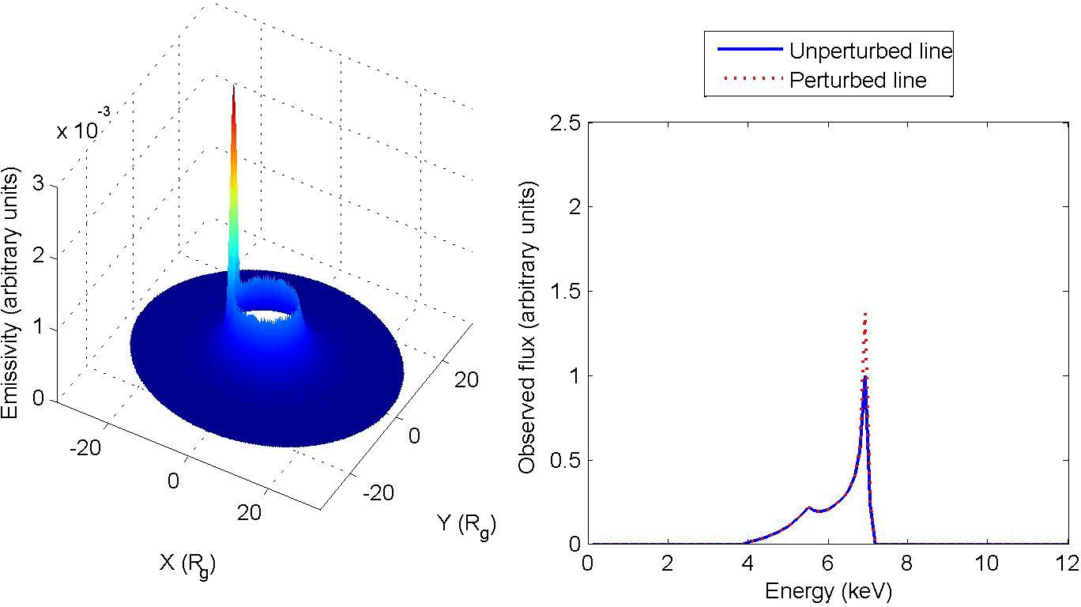
Numerical simulations of emissivity perturbations along the receding (top) and approaching (bottom) side of the disk in Schwarzschild metric
Variations due to perturbations in disk emissivity
Jovanović, P., Popović, L. Č., Stalevski, M., Shapovalova, A. I. 2010. ApJ, 718, 168

Slide 20
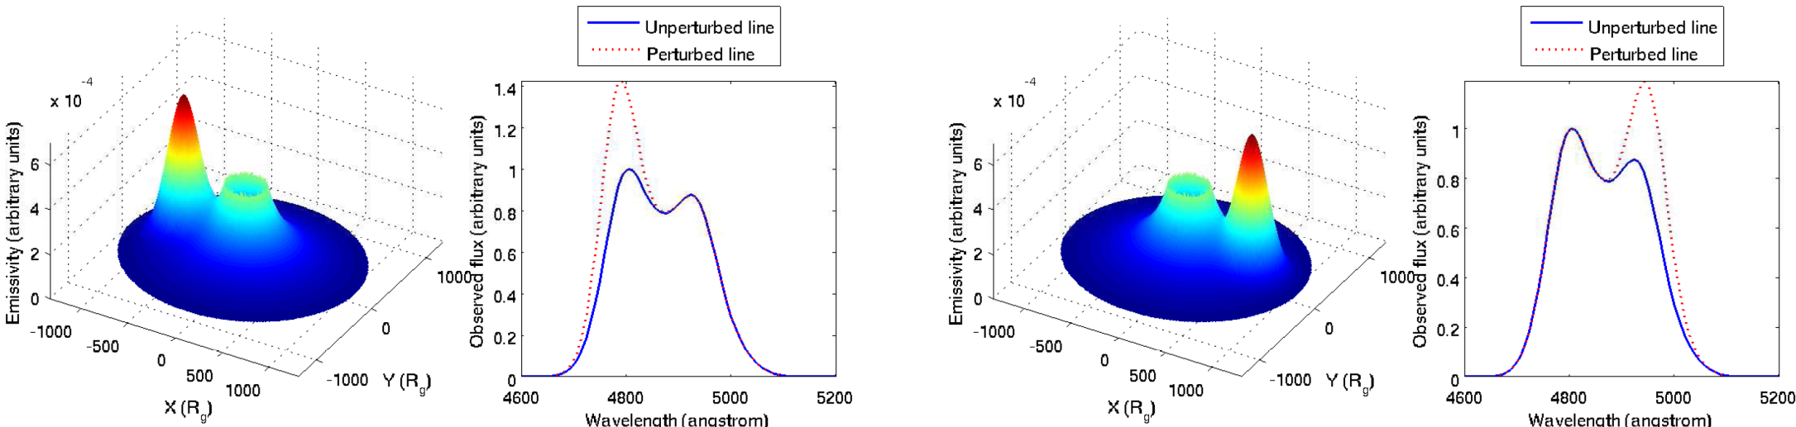
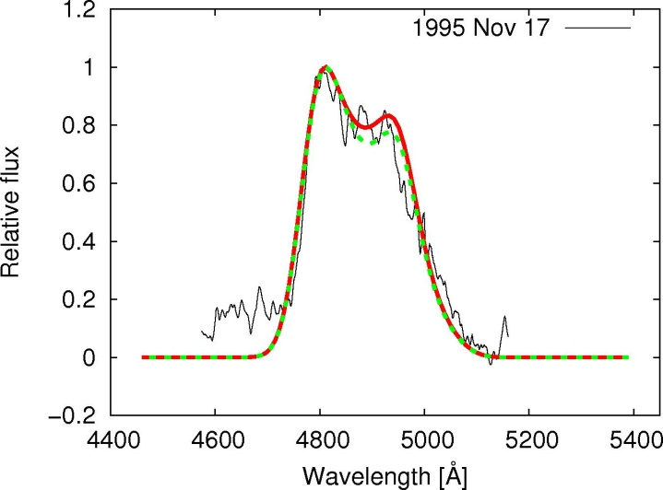
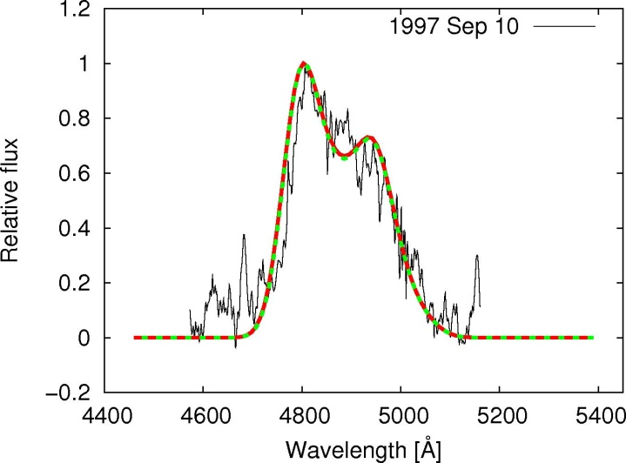
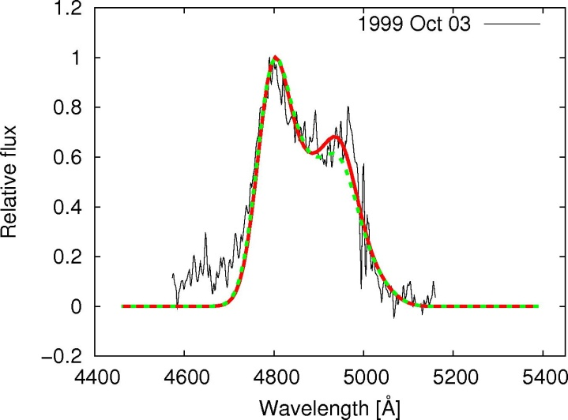
Variations of the Hβ line in the case of quasar 3C390.3
Jovanović et al. 2010, ApJ, 718, 168

Slide 21
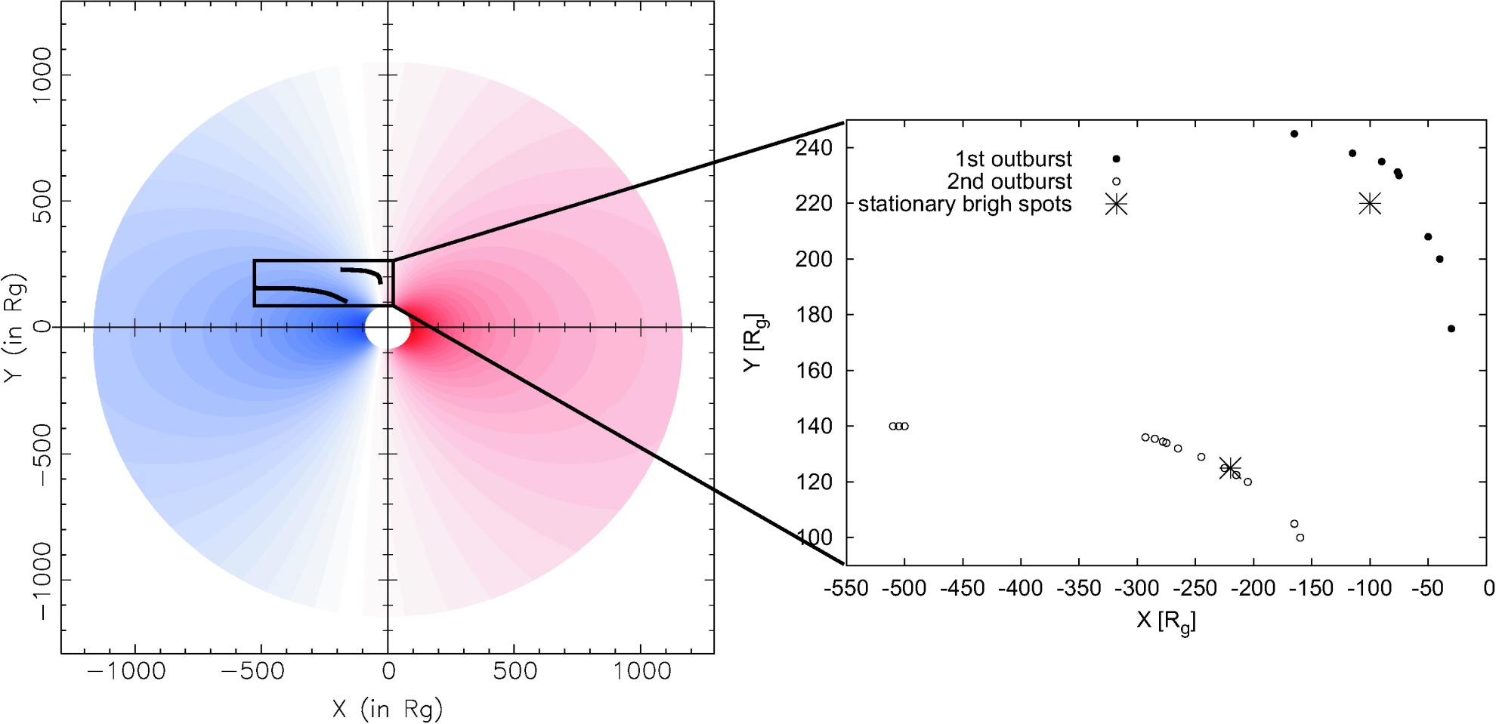
Jovanović et al. 2010, ApJ, 718, 168

Slide 22
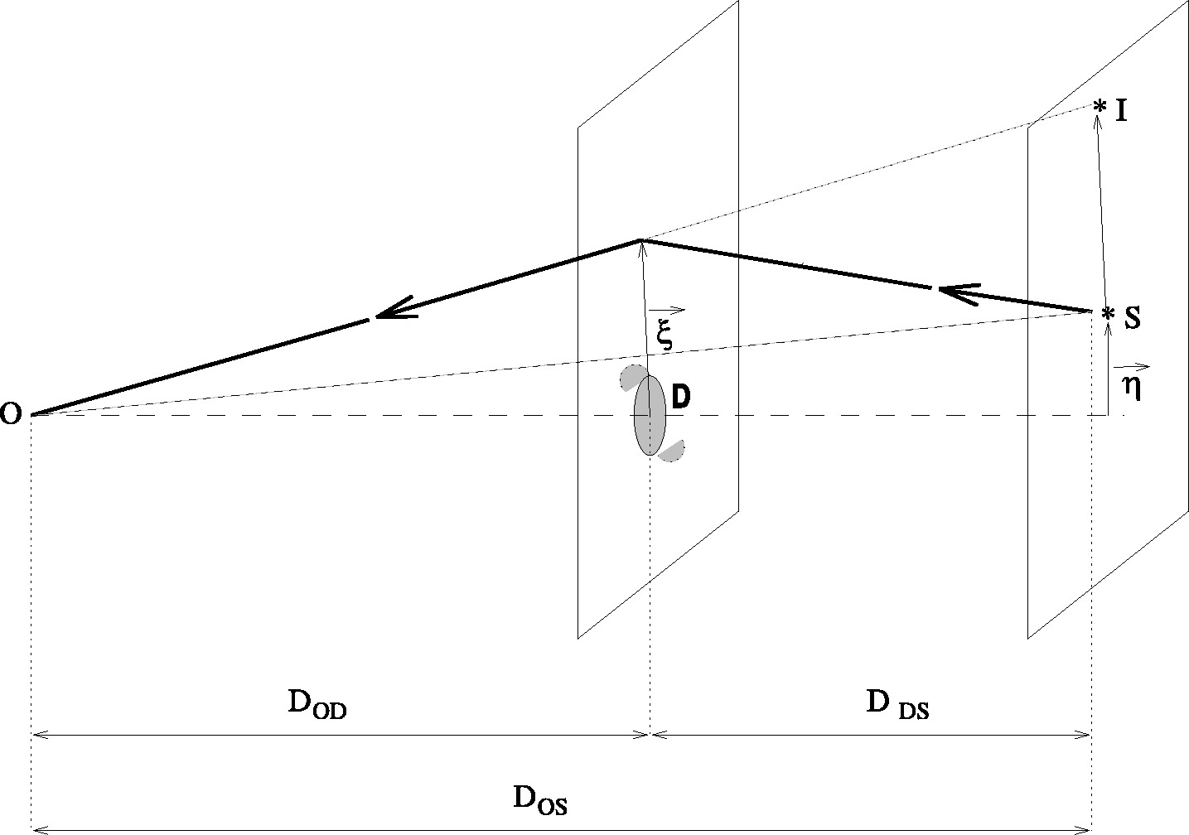
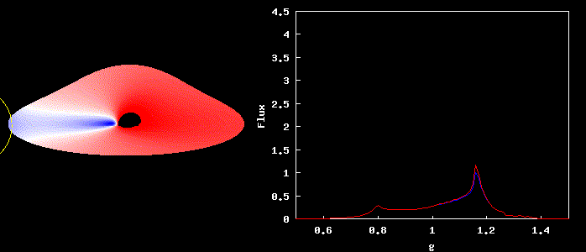
Variations due to gravitational microlensing
Einstein radius:

Slide 23
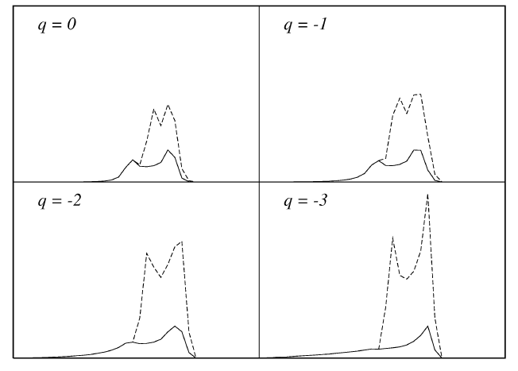
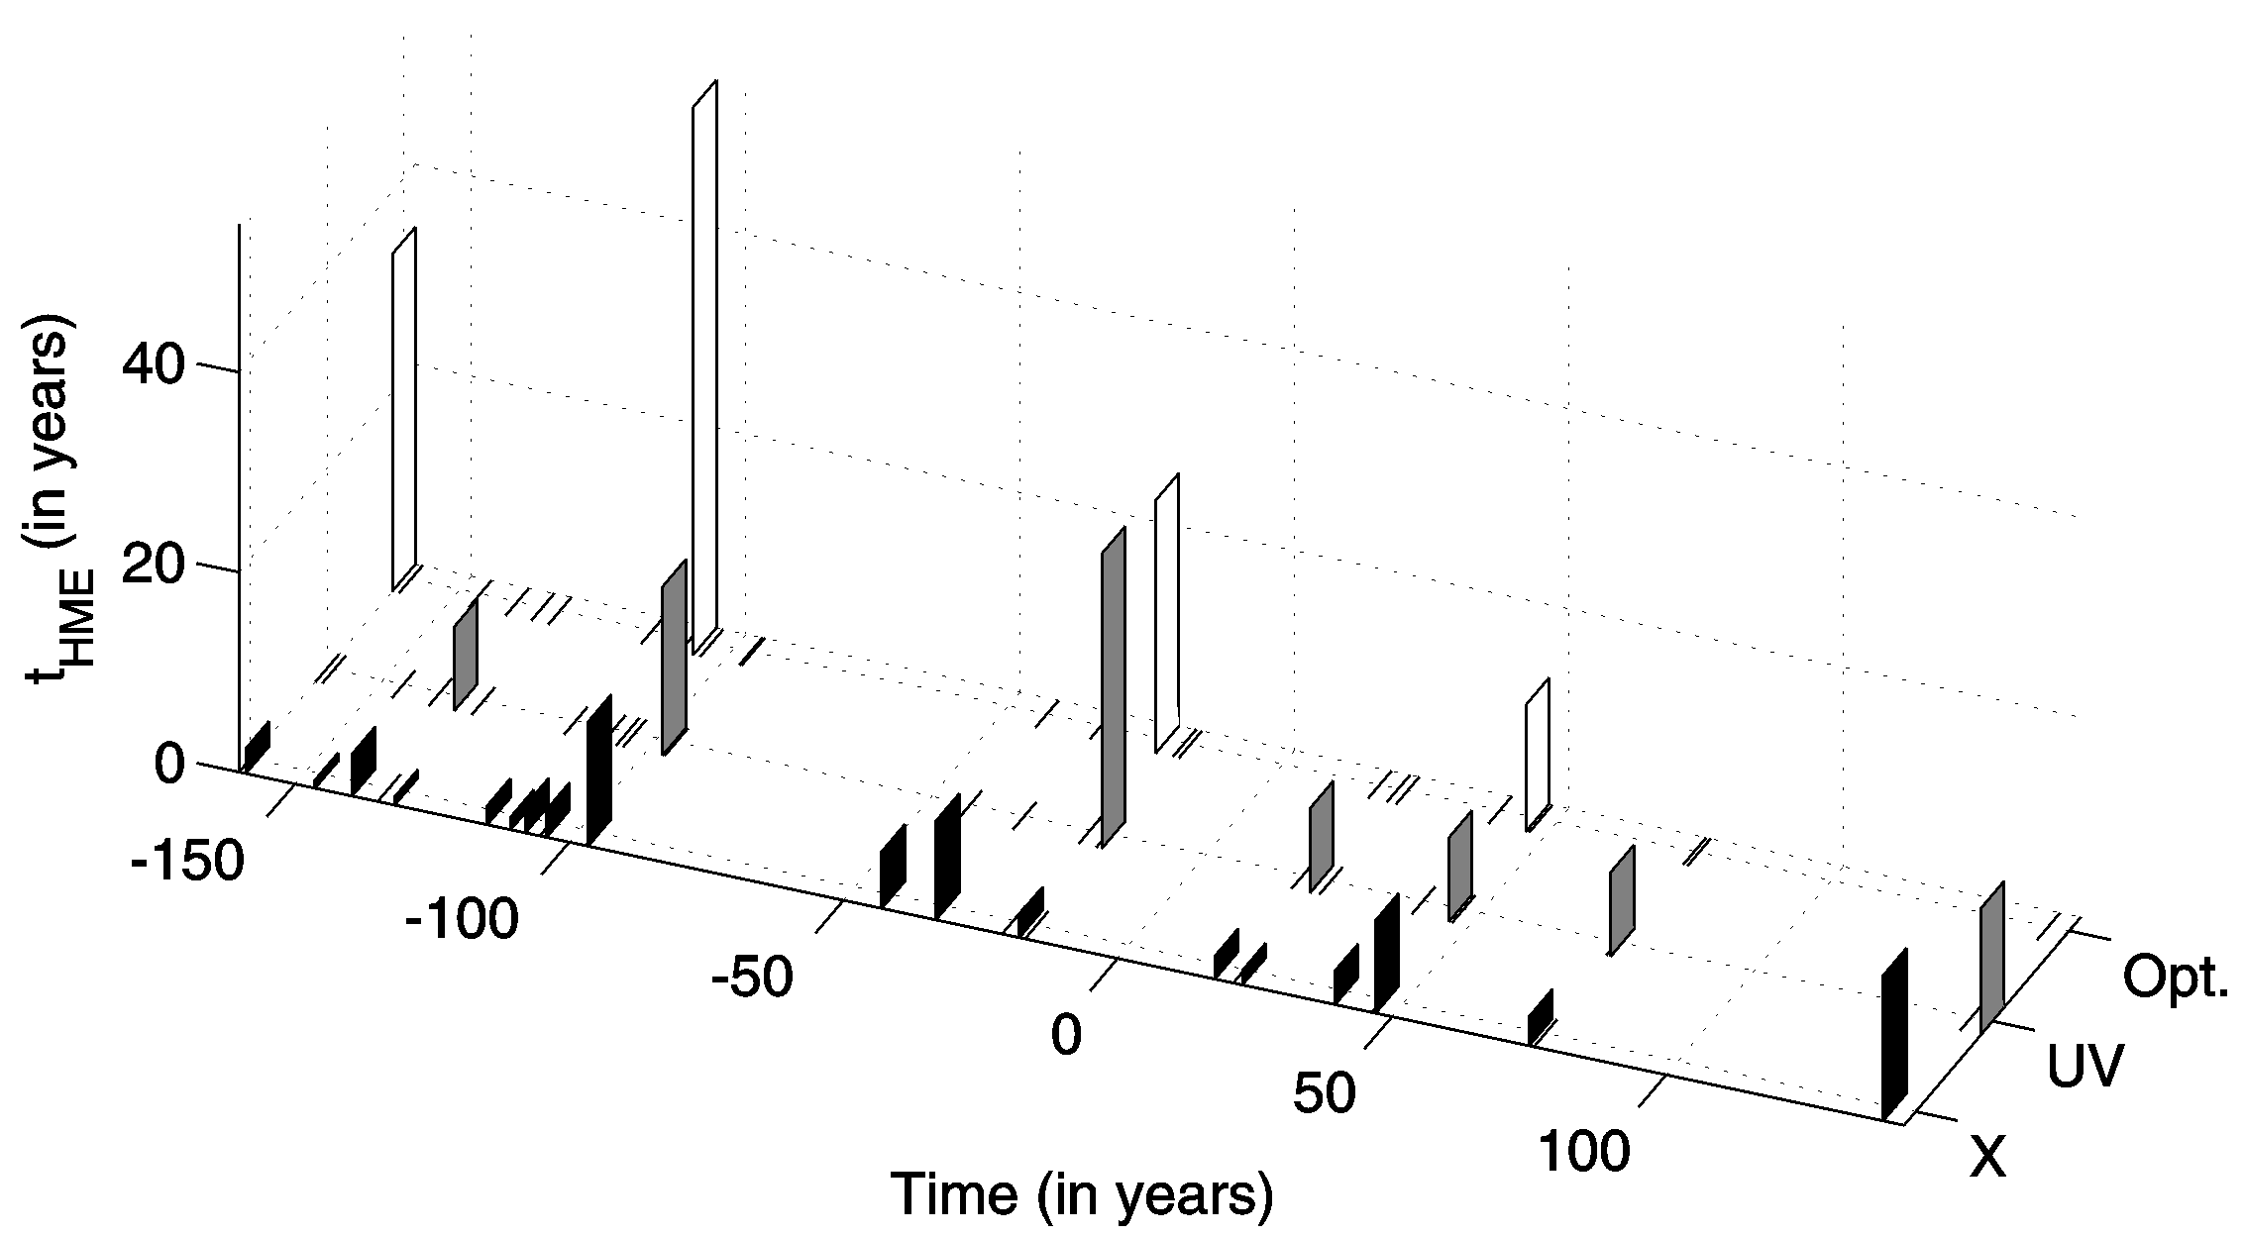
Jovanović, Zakharov, Popović, Petrović, 2008. MNRAS, 386, 397
Popović, Jovanović, Mediavilla, Zakharov, Abajas, Muñoz, Chartas, 2006, ApJ, 637, 620

Slide 24
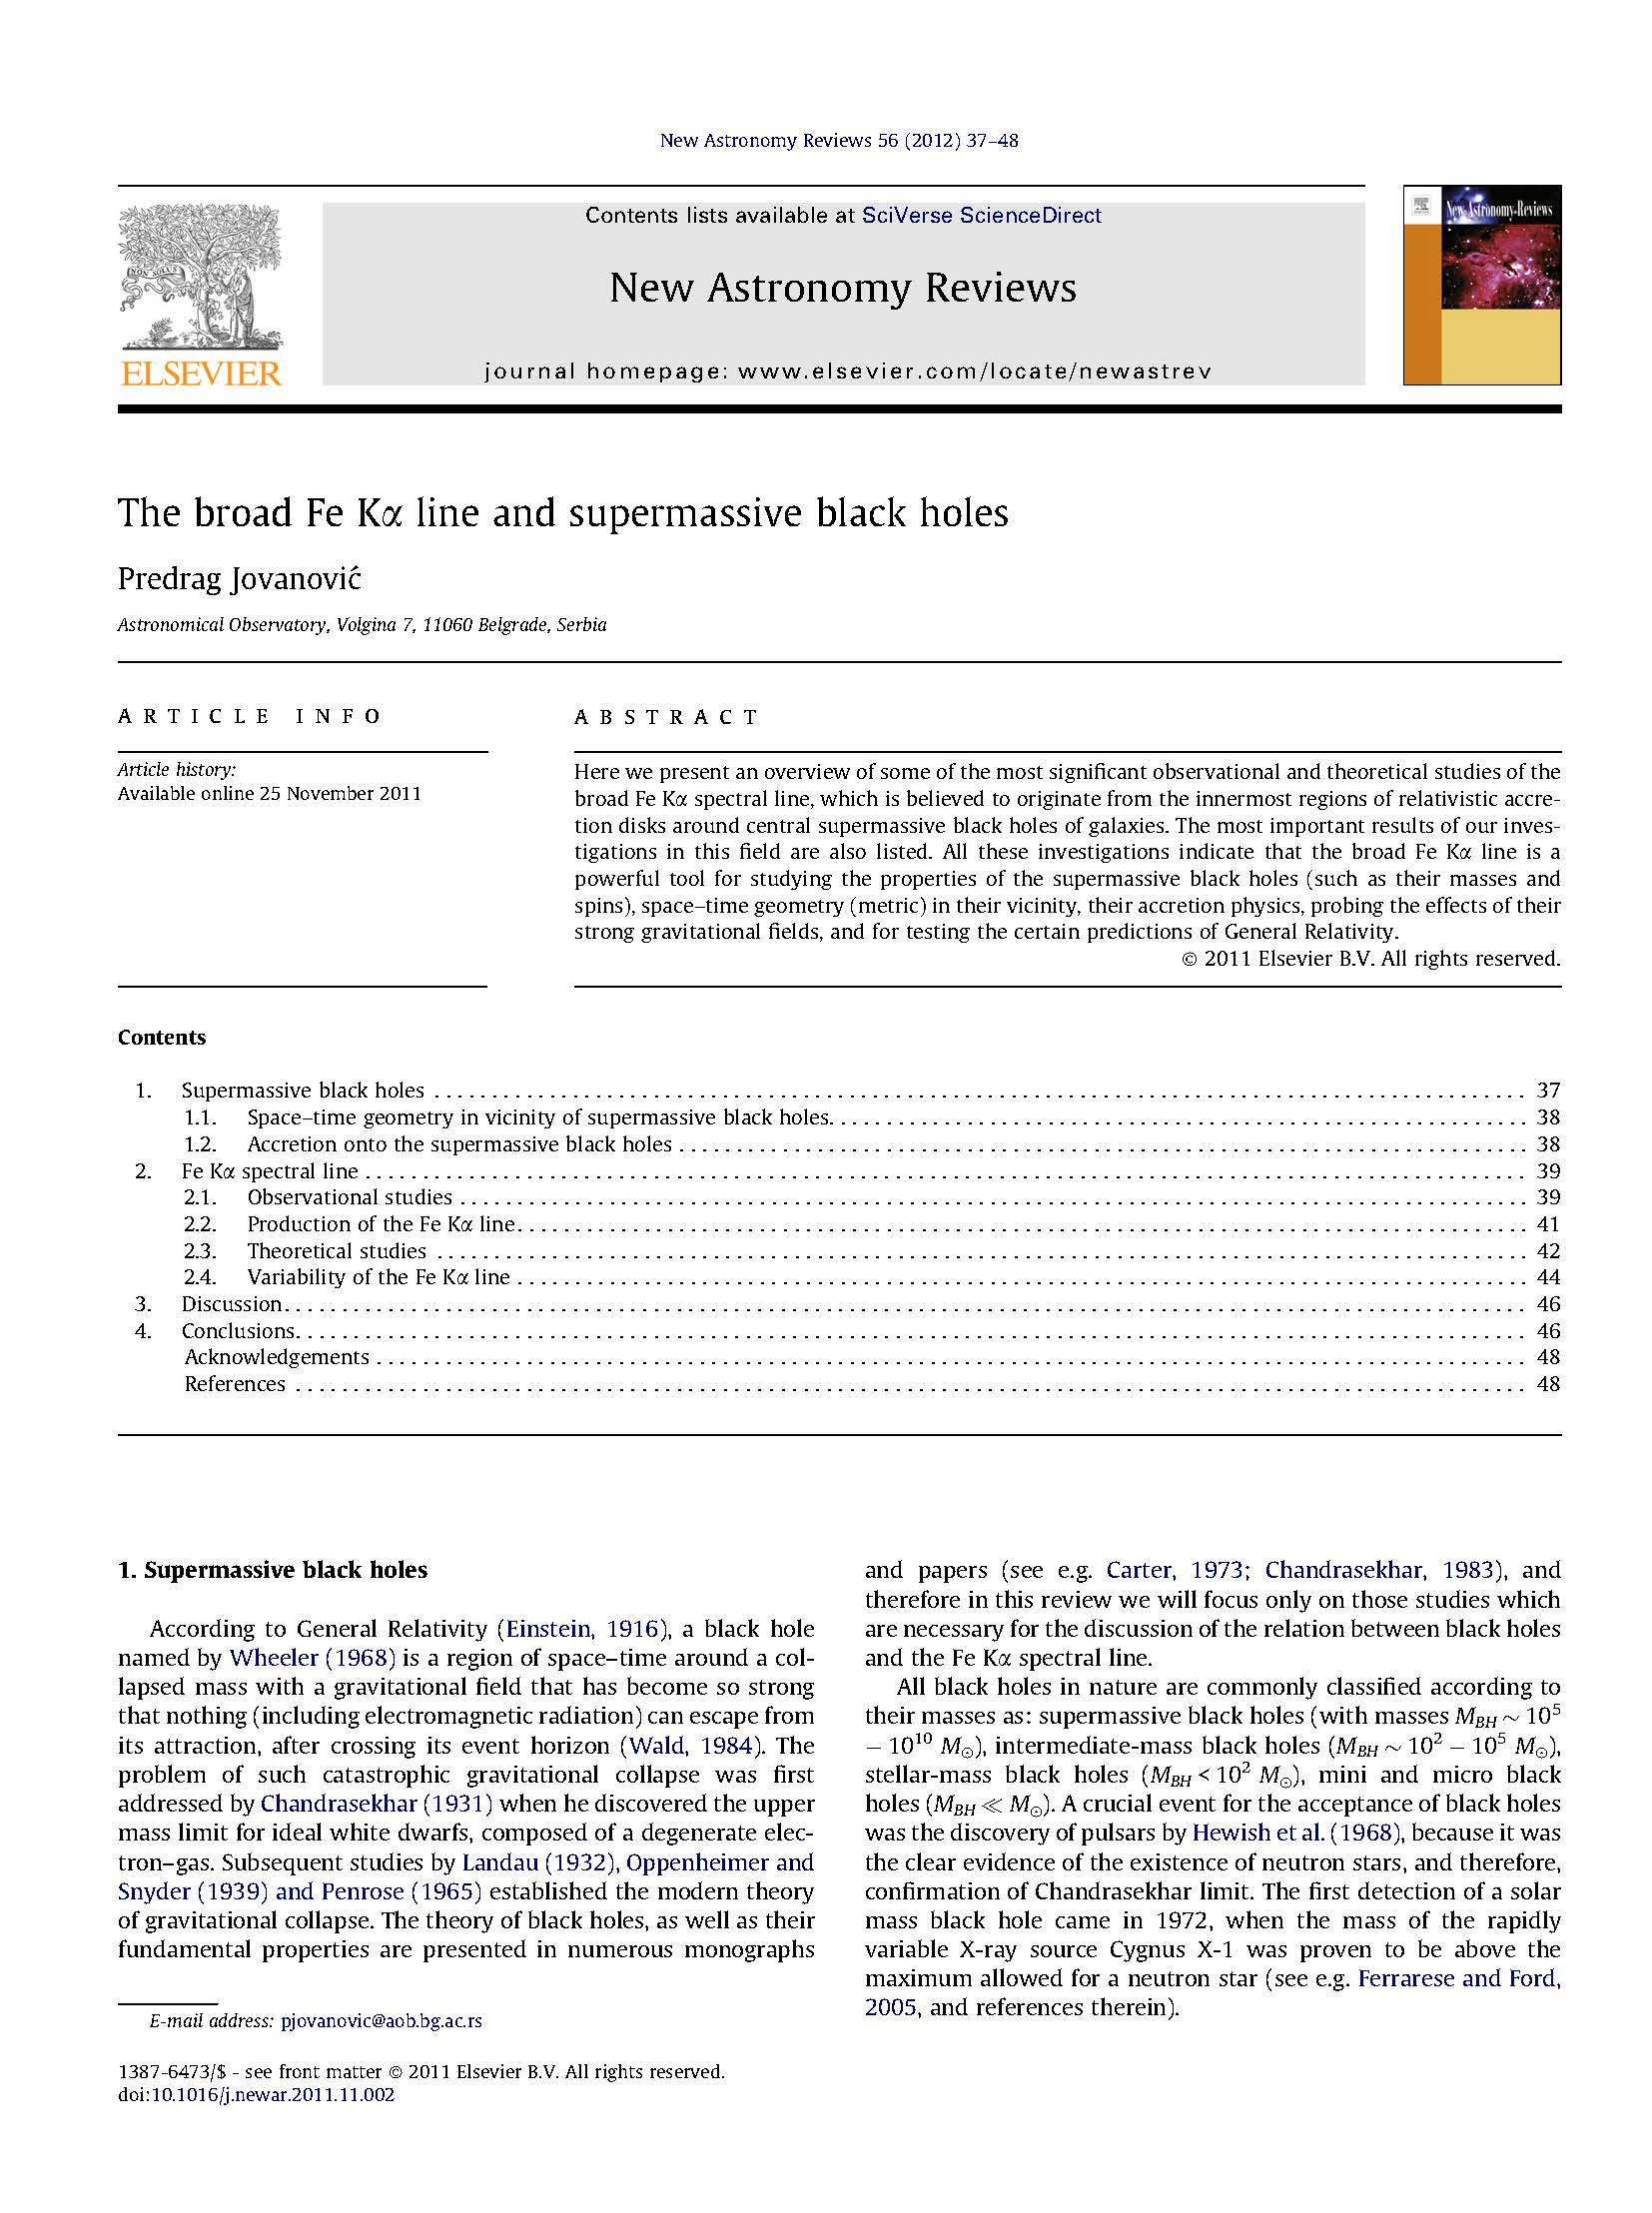

Slide 25
Conclusions
We developed a model of an accretion disk around a SMBH hole using numerical simulations based on a ray-tracing method in Kerr metric
This model allows us to study the radiation which originates in vicinity of the SMBHs
Comparison of simulations with observations enables us to:
  determine the space-time geometry in vicinity of the SMBHs
  determine the properties of SMBHs
  probe strong gravity effects and test GR predictions
  study accretion physics

Slide 26
Thank you for attention!

